Slide 1
HOSTEL MANAGEMENT SYSTEM FOR COLLEGE STUDENTS
J . Madhu
192011397
CSA3731-Software Testing For
Android Applications
31/01/2023

Slide 2
CONTENT:
Objective
Abstract
Proposed System
Flow chart
Concept map
Test cases
App tools and installation
Implementing testing screenshots
Test case outcomes
conclusion

Slide 3
OBJECTIVES:
Admin send the approval notification to every approved student via email.
Automatically insert students details to the hosteller’s record when the allotment is confirmed by the admin and deleted when vacation is conformed or after the course end date.

Slide 4
ABSTRACT :
The “HOSTEL MANAGEMENT SYSTEM” is an application developed for managing various activities in the hostel .This project deals with the problems of managing a hostel and avoids the problems which occur when carried manually.
This application is useful to avoid the manual data entry and is easy to access the data about the hostels. There by the management of hostel becomes easier to maintain and access . This application is provided with easily understandable and user friendly GUL.

Slide 5
PROPOSED SYSTEM:
This project is aimed at developing a system for keeping records and showing information about or in a hostel.
This system will provide full information about a student in the hostel .
It will show rooms available or not and number of people in a particular room.
Create Account and Login
Person details
Room allotment
Room Fee
Caution deposit fee
Search Module
Report generation
Payment gateway
Check out
Payment slip

Slide 6
FLOWCHART:
Start
Admin
Login ID and Password
Check login ID &Password
Invalid Login/Password
Login to the system successfully
Set userlevel and permissions
Stop
Access the internal functionalities according to permission

Slide 7
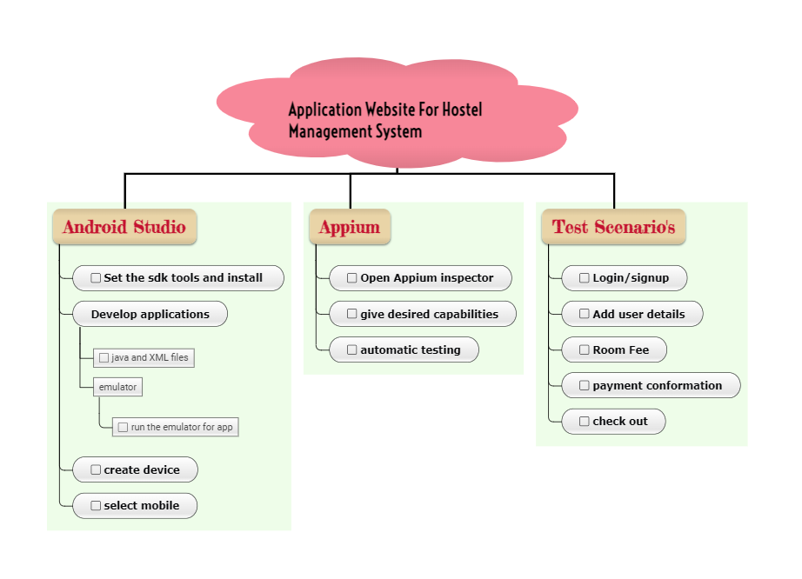
CONCEPT MAP:

Slide 8
TEST CASES:
Create Account and Login
Person details
Room allotment
Room Fee
Caution deposit fee
Search Module
Report generation
Payment gateway
Check out
Payment slip

Slide 9

APPS TOOLS ANDINSTALLATION:

Slide 10
APP TOOLS AND INSTALLATION(Cont..):
APPIUM:
Appium is an open source automation tool
We can call it an open source automation framework
It allows us to automate the different type of mobile applications
It could be a web application ,it could be a native or hybrid application
It works on emulator as well as real device’s

Slide 11
APP TOOLS AND INSTALLATION(Cont..):
Android studio:
Android studio is the official integrated development environment (IDE) for android application development.
It is based on IntelliJ IDEA ,a java integrated development environment for software ,and incorporates its code editing and developer tools.
To support application development with in the android operating system , Android Studio uses a Gradle-based build system ,emulator ,code templates and Git hub integration.
Every project in Android Studio has one or more modalities with source code and resource files.

Slide 12
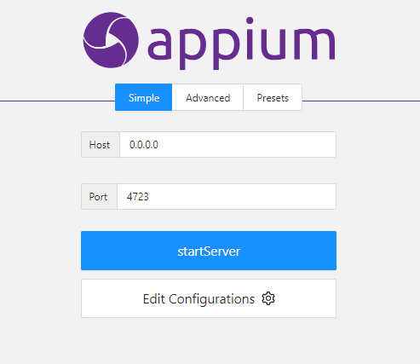
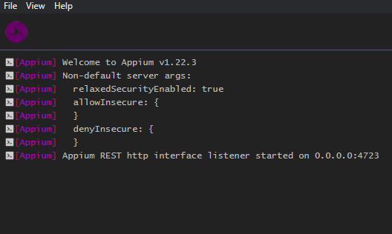
APPIUM SERVER:

Slide 13
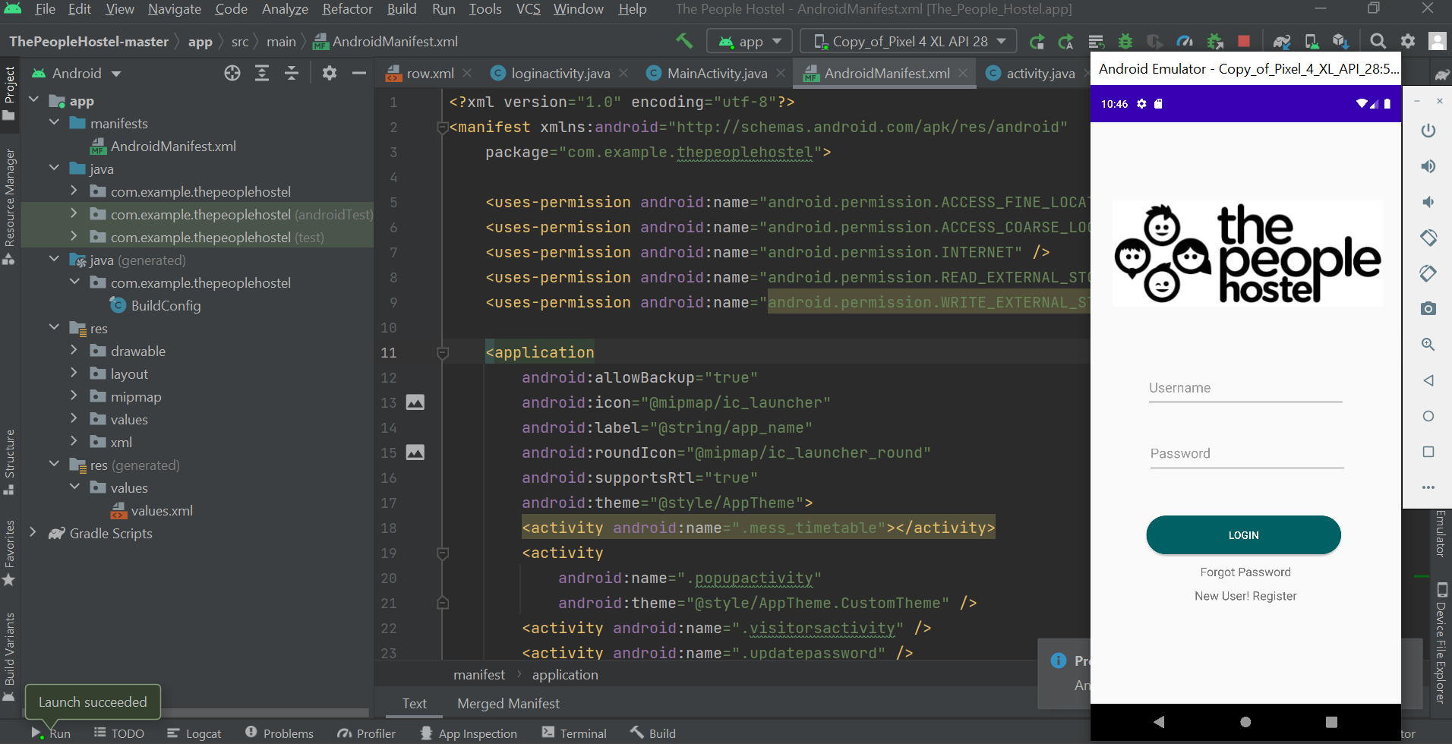
ANDROID STUDIO:

Slide 14
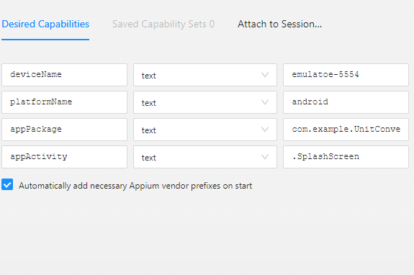
APPIUM INSPECTOR(DESIRED CAPABILITIES):
Give the Desired Capabilities in Appium Inspector.
It will start the session and gives you java code to start testing.
Paste the code in IntelliJ IDE and Start the Testing.

Slide 15
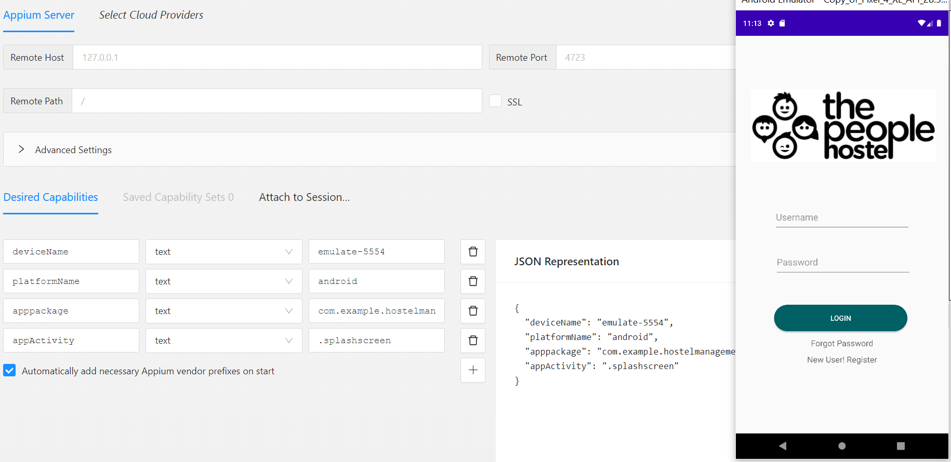
TESTING OUTPUT:

Slide 16
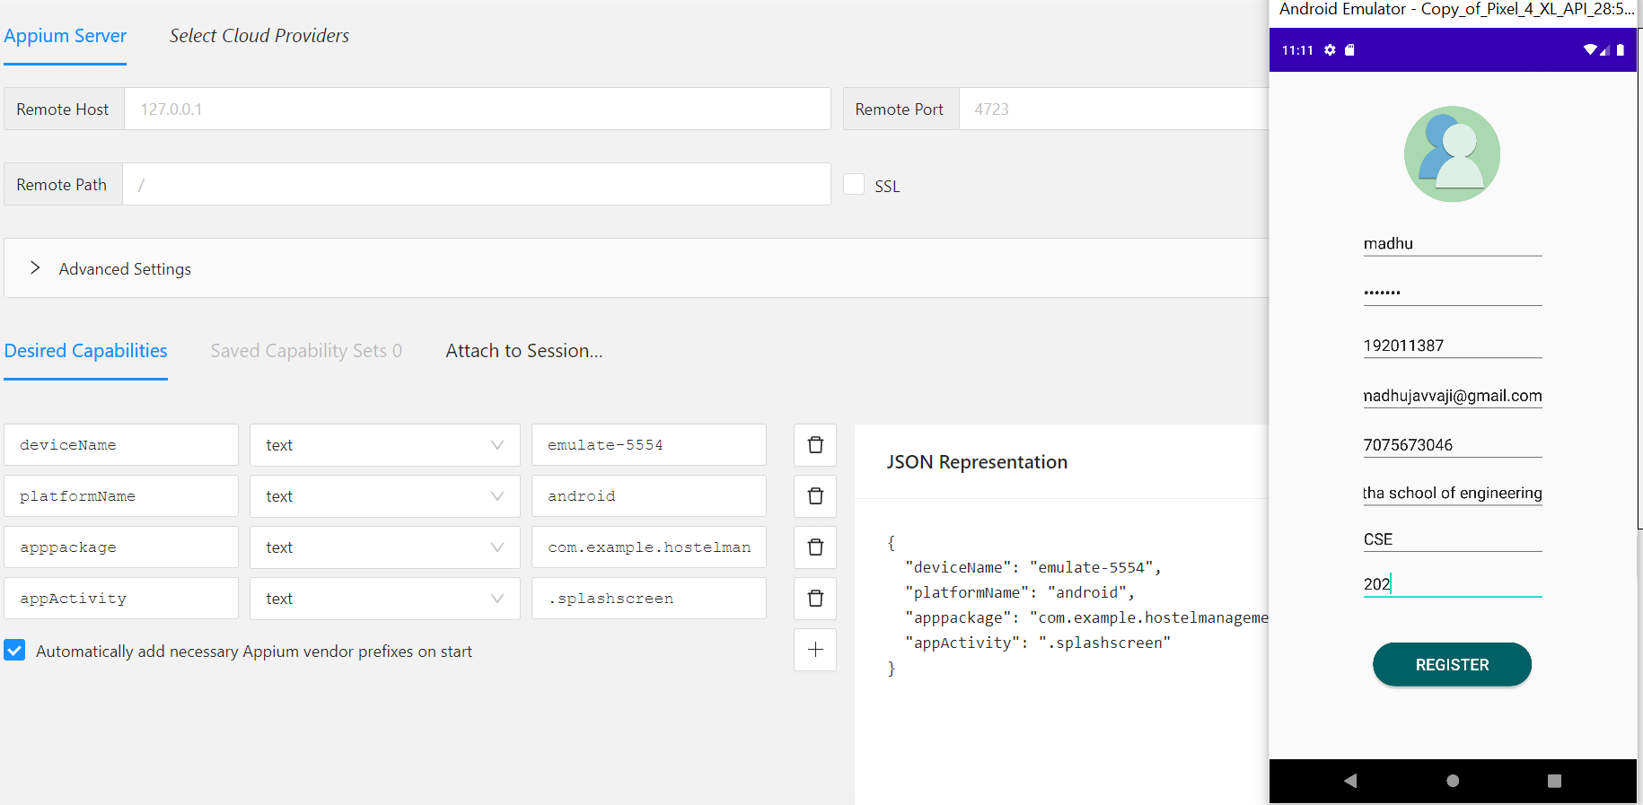
TESTING OUTPUT:

Slide 17
TEST CASE OUTCOMES:
TEST CASES | POSITIVE/NEGATIVE
Verify if a user will be able to login with valid username and password. | Positive
Verify if a user cannot login with a valid username and invalid password. | Negative
Verify the register account page , when filled the blank space and submit button is clicked. | Positive
Verify the register account page , when not filled the blank space and submit button is clicked. | Negative
Verify the forget password functionality. | Positive
Verify if user is able to login with a new password only after he/she has changed the password. | Positive
Verify the user able to check and select the room in hostel(AC/NON-AC). | Positive
Verify the payment method for hostel room. | Positive
Verify the instant refund is not possible for room. | Negative

Slide 18
CONCLUSION:
Hence , the Hostel management system application is developed using The Android Studio.
Then , the Hostel management system application accessed using the Emulator.
All the possible outcomes were tested using the Appium server.
The testing of this website has the positive and negative.
Overall , using Appium for testing Hostel management System software can greatly improve the quality and reliability of the software.

